Slide 1
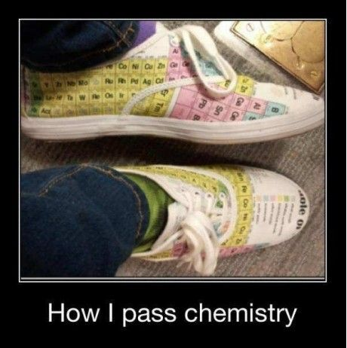

Slide 2
A2 Chemistry
The Kinetic Theory

Slide 3
Review
So far, we’ve learned about the shape and polarity of molecules and the intermolecular forces that affect their physical properties, like melting and boiling point, vapour pressure and solubility…

Slide 4
Objectives
the behaviour of an ideal gas, including the qualitative relationships between pressure, temperature and volume, can be explained using the Kinetic Theory

Slide 5
Key terms
Kinetic
Assumption
Particle
Behaviour
Real gas
Ideal gas
Negligible

Slide 6
The Kinetic Theory
The Kinetic Theory is a model that is used to explain the physical properties or behaviour of gases. It makes certain assumptions:
Particles are in constant, rapid, random straight line motion unless they collide with each other or the wall of their container.
Attractive and repulsive forces between particles is negligible.
The volume of particles is negligible compared to the total volume occupied.
The particles have kinetic energy which is determined by their speed and mass.
The average kinetic energy is proportional to its temperature, and is the same for all gases at the same temperature.
Particle collisions are perfectly elastic.

Slide 7
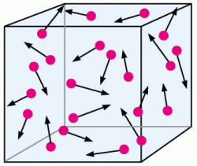
Behaviour of gases
Take the shape and volume of their container, due to constant random motion and negligible forces between them. This causes them to spread out as far as possible.

Slide 8
Compressible (elastic), due to large spaces between particles.

Slide 9
Diffuse through other gases, due to constant random motion and negligible forces of attraction.

Slide 10
Exert pressure, due to particle collisions with the wall of their container. The more frequent and forceful these collisions, the greater the force, so pressure can be increased by increasing the temperature or decreasing the volume.

Slide 11
Ideal gases
The Kinetic Theory applies to ideal gases, but real gases do have particles that occupy significant (although small) volumes and forces of attraction and repulsion between them that become significant under pressure or low temperatures.
Ideal gases occupy no volume at absolute zero, but real gases turn into liquids or solids before they can shrink that much.

Slide 12
